Slide 1
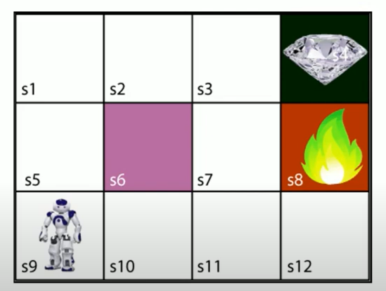
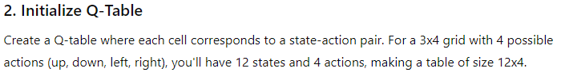
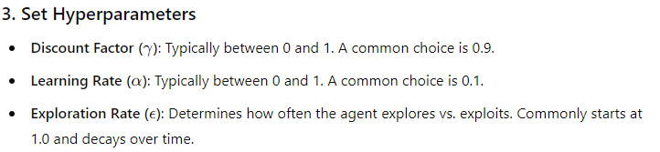
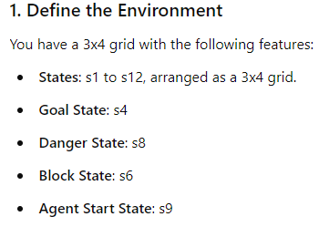
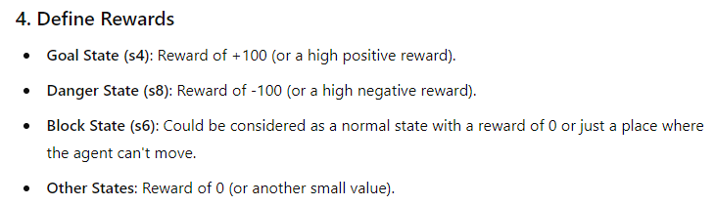

Slide 2
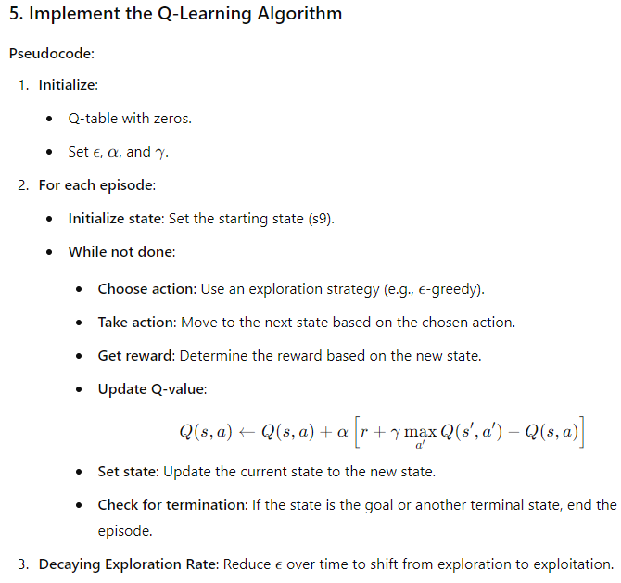
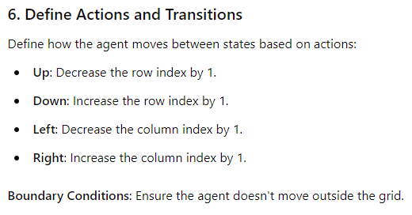

Slide 3
import numpy as np
import random
# Define constants
N_STATES = 12
N_ACTIONS = 4 # Up, Down, Left, Right
EPISODES = 1000
ALPHA = 0.1
GAMMA = 0.9
EPSILON = 1.0
EPSILON_DECAY = 0.995
MIN_EPSILON = 0.01
# Initialize Q-table
Q = np.zeros((N_STATES, N_ACTIONS))
# Define rewards
REWARDS = np.zeros(N_STATES)
REWARDS[3] = 100 # Goal state (s4)
REWARDS[7] = -100 # Danger state (s8)
# Define state transitions
def get_next_state(state, action):
row, col = divmod(state, 4)
if action == 0: # Up
row -= 1
elif action == 1: # Down
row += 1
elif action == 2: # Left
col -= 1
elif action == 3: # Right
col += 1
new_state = row * 4 + col
if 0 <= row < 3 and 0 <= col < 4:
return new_state
return state # Stay in place if out of bounds
# Training the agent
for episode in range(EPISODES):
state = 8 # Starting state (s9)
done = False
while not done:
# Choose action
if random.uniform(0, 1) < EPSILON:
action = random.randint(0, N_ACTIONS - 1)
else:
action = np.argmax(Q[state])
# Take action
next_state = get_next_state(state, action)
reward = REWARDS[next_state]
# Update Q-table
best_next_action = np.argmax(Q[next_state])
Q[state, action] += ALPHA * (reward + GAMMA * Q[next_state, best_next_action] - Q[state, action])
# Update state
state = next_state
if state == 3 or state == 7:
done = True # End episode if goal or danger state
# Decay epsilon
EPSILON = max(MIN_EPSILON, EPSILON * EPSILON_DECAY)
print("Training complete.")
print("Q-table:")
print(Q)

Slide 4
Training complete.
Q-table:
[
[ 72.5948504 65.33579358 72.49652551 81. ]
[ 80.92825897 72.4912303 72.67420377 90. ]
[ 89.32859687 80.16533294 80.84314395 100. ]
[ 0. 0. 0. 0. ]
[ 72.9 58.4504486 65.05748387 72.62819442]
[ 80.99975381 40.63834786 53.7959139 68.50288279]
[ 89.9259181 36.33572491 35.48238409 -94.76652367]
[ 0. 0. 0. 0. ]
[ 65.61 58.69185769 58.89820019 63.22220075]
[ 72.28957518 31.76659568 33.63261287 33.27515527]
[ 70.33931829 13.2773535 9.60959829 4.57175729]
[-46.8559 0.70353093 18.24621834 0.10952207]
]

